Slide 1

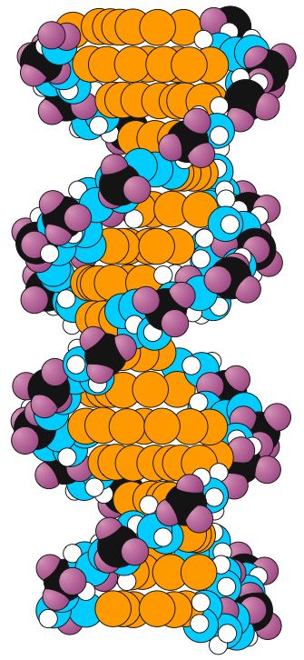

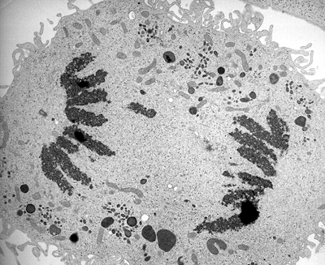
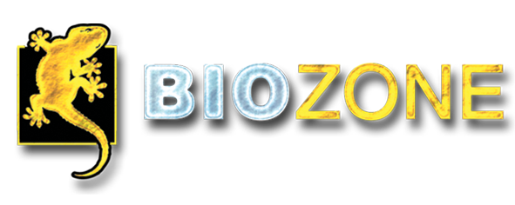
Genes & Inheritance Series: Set 3
Copyright © 2005
Version: 2.0

Slide 2

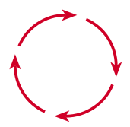
Metabolism
The life processes of cells and organisms are a vast number of chemical reactions collectively called metabolism.
Metabolism is defined as “the chemical activities of life; all the various processes by which you obtain energy, grow, heal, think, feel, and dispose of wastes”.
The average adult human eats 1 tonne of food per year yet, after growth, body size and composition generally stays much the same.
Metabolism

Slide 3

Maintaining the Organism
Most of the food and fluid we eat and absorb is passed out again.
Nutrients are modified or converted in one of the many chemical pathways that constitute metabolism.
These complex chemical reactions must take place to maintain the organism.
All metabolic reactions occur in steps, which are controlled by enzymes.
  Failure of a even single enzyme can lead to collapse of a system and death.
Metabolism

Slide 4
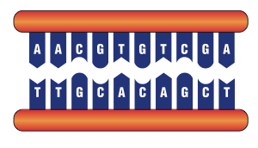

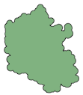
Control of Metabolism
Metabolism is controlled by a vast number of enzyme-controlled metabolic pathways.
Most enzymes are proteins, which are encoded by genes.
The regulation of gene activity controls the production of enzymes.
Other factors can regulate the activity of enzymes after production.
Gene expression is regulated by other 'controller genes'
DNA
Contains 'blueprint' for the manufacture of all proteins
Transcription
mRNA
Translation
Protein
Some proteins are enzymes that control cell metabolism.
Enzyme activity is controlled by a number of factors

Slide 5
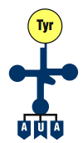
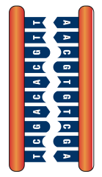

Gene Expression
Genes code for the production of proteins:
Reverse transcription occurs when retroviruses invade host cells. Their viral RNA is converted to DNA and spliced into the host's genome
tRNA is a carrier molecule which brings in amino acids, in their correct sequence, to make a polypeptide chain.
Amino acid
Structural?
tRNA
Regulatory?
Contractile?
Immunological?
Transcription
Translation
Transport?
DNA
mRNA
Protein
Catalytic?
DNA contains the master copy of all the genetic information to produce proteins for the cell.
mRNA is an exact copy of part of the DNA molecule coding for making a single protein.
Proteins are composed of polypeptide chains. More than one may be required to form a functional protein.
Proteins have many roles within and outside cells

Slide 6
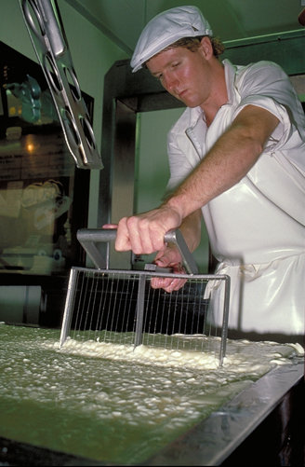
Enzymes
Enzymes are biological catalysts, regulating cell metabolism.
An enzyme acts on a molecule called the substrate.
Enzymes are specific for the reactions they catalyze.
Enzyme activity depends on the enzyme’s shape and its active site (the binding site for the substrate).
Enzymes are often named for the substrate on which they work, and sometimes include the suffix -ase:
  Lipase breaks down fats (lipids)
  Amylase breaks down starch (amylose/amylopectin)
  Lactase breaks down milk sugar (lactose)
  Cholinesterase breaks down the neurotransmitter acetylcholine in the nervous system
Cheese making relies on the enzyme rennin, which coagulates milk protein to make a curd

Slide 7
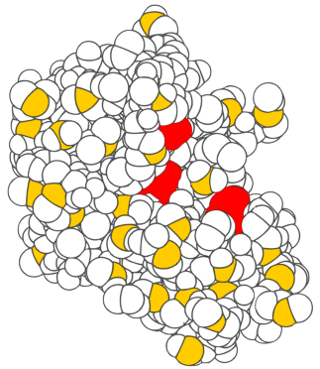
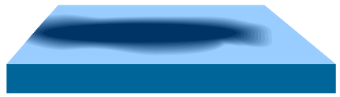
Enzyme Structure
The substrate is the chemical that an enzyme acts on
RNA
Ribonuclease S (right) is an enzyme that breaks up RNA molecules.
The red areas designate the active site and comprise certain amino acid 'R' groups.
The substrate (in this case, RNA) is drawn into the active site, putting the substrate molecule under stress, thereby causing the reaction to proceed more readily.
Active sites are attraction points that draw the substrate to the surface of the enzyme
Source: Lubert Stryer
Enzymes are specific catalysts. The complexity of the active site makes each enzyme specific for the substrate it acts on.

Slide 8


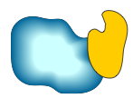
Functional Enzyme
Nearly all enzymes are made of protein, although RNA can also have enzymic properties.
Some enzymes contain only protein.
Others, called conjugated protein enzymes, require additional components to complete their catalytic properties.
  These may be permanently attached parts called prosthetic groups, or temporarily attached non-protein coenzymes, which detach after a reaction and may then participate with another enzyme in other reactions.
Protein-only Enzymes
Active site
Enzyme comprising only protein
e.g. lysozyme
Enzyme
Conjugated Protein Enzymes
Prosthetic group
Coenzyme
Apoenzyme
Apoenzyme
Prosthetic group is required for function
Coenzyme is required for function

Slide 9
Conjugated Protein Enzymes
The prosthetic group remains more or less permanently attached
The coenzyme becomes detached from the apoenzyme after the reaction and may go on participate in further reactions
Active site
Active site
Apoenzyme alone is inactive
Apoenzyme
Prosthetic group required
Contains the apoenzyme (protein) plus a prosthetic group
e.g. Flavoprotein + FAD
Coenzyme required
Contains the apoenzyme (protein) plus a coenzyme (non-protein)
e.g. Dehydrogenases + NAD

Slide 10
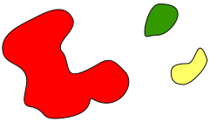


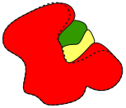
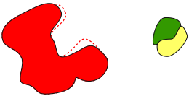

Mechanism of Enzyme Action
Steps in Enzyme Activity
In the induced fit model of enzyme function, the enzyme fits to its substrate somewhat like a lock and key, with the shape of the enzyme changing when the substrate fits into the cleft of the active site.
The specificity of the substrate is determined by the complexity of the binding sites.
The wrong substrates will not fit into the active site.
Some enzymes have specificity to a bond type (e.g. lipases break up any chain length of lipid).
Substrate molecules
Two substrate molecules are drawn into the cleft of the enzyme’s active site.
Enzyme
The shape of the enzyme’s active site is modified by its interaction with the substrate(s). The shape changes force the substrate molecules to combine.
Cleft
Enzyme changes shape
Enzyme
The resulting end product is released by the enzyme, which returns to its normal shape, ready to receive more substrate.
Enzyme
End product is released

Slide 11
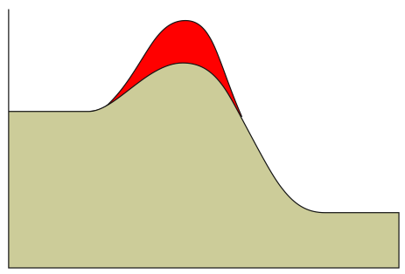
Enzymes are Catalysts
Catalysts are substances that increase the rate of chemical reactions. All catalysts speed up reactions by:
  Influencing the stability of bonds in the reactants.
  Providing an alternative reaction pathway; the binding of reactants and enzyme can weaken bonds in the reactants and allow the reaction to proceed more easily.
Enzymes are biological
catalysts; they alter the
chemical equilibrium between
the reactant and the product.
When the substrate attains
the required energy it is able
to change into the product or
products.
High
Without enzyme
Reactant
With enzyme
High energy
Amount of energy stored in the chemicals
Product
Low energy
Low
Start
Finish
Direction of reaction

Slide 12
Enzymes are Catalysts
Catalysts provide an alternative pathway of lower activation energy.
Without enzyme present, the energy needed to make the reaction proceed in the forward direction (the activation energy) is very high.
High
With enzyme present, the energy required for the reaction to proceed is reduced (the activation energy is lower). Reactants turn into products more readily.
Reactant
High energy
Amount of energy stored in the chemicals
Product
Low energy
Low
Start
Finish
Direction of reaction

Slide 13
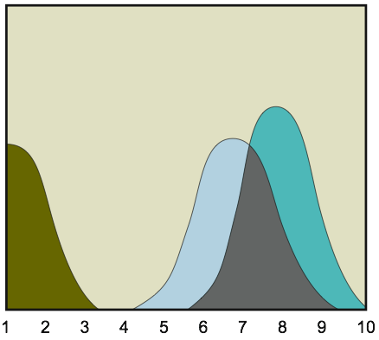
Effects of pH on Enzymes
Like all proteins, enzymes are denatured (made non-functional) by extremes of pH (acid/alkaline).
Within these extremes most enzymes are still influenced by pH.
There is a particular pH for optimum activity for each enzyme. This is because the active sites of the enzyme can be disabled by the wrong pH.
Optimum pH for pepsin
Optimum pH for urease
Optimum pH for trypsin
Trypsin
Pepsin
Enzyme activity
Urease
Acid
Alkaline
pH

Slide 14
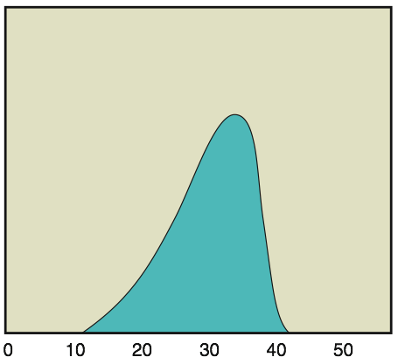
Temperature and Enzyme Activity
Reactions occur faster at higher temperatures, but the rate of denaturation of enzymes also increases at higher temperatures.
High temperatures break the disulfide bonds important for the tertiary structure of the enzyme.
This destroys the active sites and therefore makes the enzyme non-functional.
Optimum temperature for enzyme
Enzyme activity
Too cold for the enzyme to operate
Rapid denaturation
Temperature (°C)

Slide 15
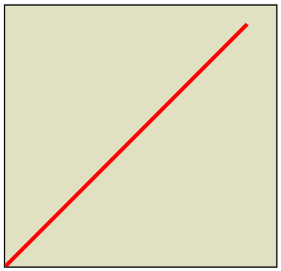
Enzyme Concentration and Enzyme Activity
Assuming that the amount of substrate is not limiting, an increase in enzyme concentration causes an increase in the reaction rate.
Cells may increase the amount of enzyme present by increasing the rate of its synthesis to meet demand.
Rate of reaction
With ample substrate and cofactors present
Enzyme concentration

Slide 16
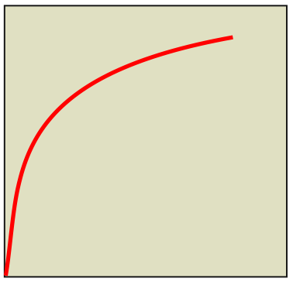
Substrate Concentration
Effect on Enzyme Activity
Assuming that the amount of enzyme is constant and non-limiting, an increase in substrate concentration causes a diminishing increase in the reaction rate.
A maximum rate is obtained at a certain substrate concentration where all enzymes are occupied by substrate. The reaction rate cannot increase further.
Rate of reaction
With ample enzyme and cofactors present
Substrate concentration

Slide 17
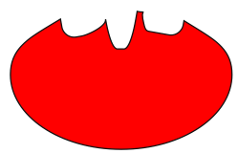
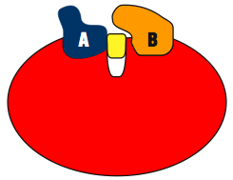

Effect of Cofactors on Enzymes
Cofactors are substances that are essential to the catalytic activity of some enzymes.
Cofactors may alter the shape of enzymes slightly to make the active sites functional or to complete the reactive site.
Enzyme cofactors can be inorganic, e.g. metal ions and iron-sulfur clusters, or organic compounds, which are known as coenzymes.
Many vitamins are coenzymes. Vitamins are organic molecules not synthesized by the body, e.g. vitamin K, B1, B6, and folate.
Once the shape of the enzyme has been modified by the cofactor, substrates A and B can react together.
Enzyme
Product
The presence of the cofactor alters the shape of the enzyme

Slide 18
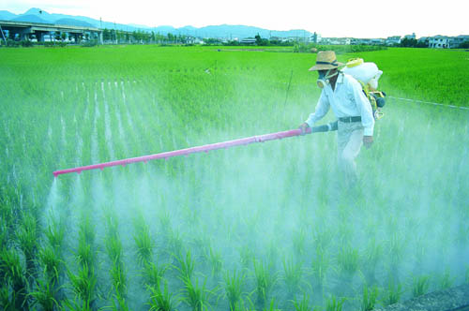
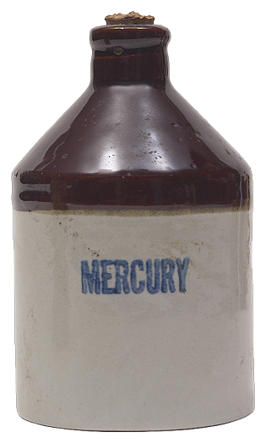
Enzyme Inhibition
Enzyme inhibitors are substances that prevent the normal action of an enzyme and thereby slow the rate of enzyme controlled reactions.
Enzyme inhibitors may or may not act reversibly.
In reversible inhibition, the inhibitor is temporarily bound to the enzyme, thereby preventing its function.
  Reversible inhibition is often a
  means by which enzyme activity
  is regulated in the functioning cell.
In irreversible inhibition, the
inhibitor (poison) may bind
permanently to the enzyme and
cause it to be permanently
deactivated.
Insecticides and heavy metals, such as mercury, are poisons that inhibit enzyme activity.

Slide 19
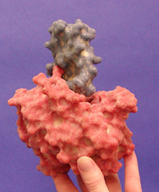
Reversible Inhibition
Reversible inhibitors are used to control the activity of enzymes.
There is often an interaction between the substrate or end product and the enzyme controlling the reaction.
Buildup of the end product or a lack of substrate may deactivate the enzyme. This deactivation can occur via competitive or noncompetitive inhibition.
  Competitive inhibitors compete with the substrate
  for the active site.
  Noncompetitive inhibitors bind to the enzyme, but
  not at the active site. The substrate can bind but
  enzyme function is impaired.
  Allosteric inhibitors are non competitive inhibitors
  that prevent the substrate from binding.
Model of elastase and its inhibitor

Slide 20
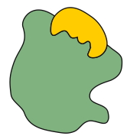
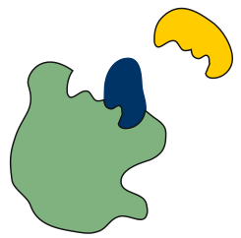
Competitive Inhibition
Competitive inhibitors compete with the substrate for the active site, thereby blocking it and preventing its attachment to the substrate.
The inhibition is reversible.
  Example: Malonate is a powerful inhibitor of cellular respiration because it is a competitive inhibitor of the enzyme succinate dehydrogenase in the Krebs cycle, which catalyzes the oxidation of succinate to fumarate.
Substrate
No inhibition
Good fit
Enzyme
Competitive inhibitor blocks the active site
Substrate
Enzyme
Competitive inhibitor
e.g. malonate

Slide 21
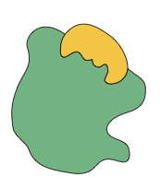
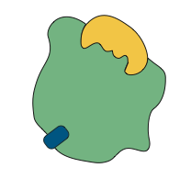
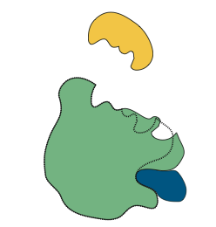
Non-Competitive Inhibition
No inhibition
Substrate
Non-competitive inhibitors bind to the enzyme, but not at the active site, and alter its shape. The substrate is still able to bind, but the reaction rate is slowed because the enzyme is less able to perform its function.
Allosteric enzyme inhibitors are non competitive inhibitors that induce a shape change that alters the active site and prevents the substrate from binding.
  In this case, the enzyme
  ceases to function.
Good fit
Enzyme
Non-competitive inhibitor
The substrate binds to the active site
The substrate cannot bind
Enzyme
Active site is distorted
Enzyme
The inhibitor binds to the enzyme, and alters the enzyme’s ability to function properly.
Allosteric inhibitor
Non-competitive inhibitor

Slide 22

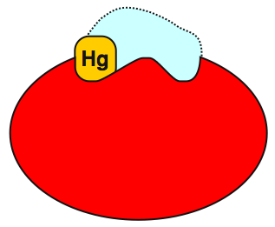
Irreversible Inhibition
Irreversible enzyme inhibitors are poisons that prevent enzyme function.
Heavy metals: Certain heavy metals bind tightly and permanently to the active sites of enzymes, destroying their catalytic properties.
  Example: mercury (Hg), cadmium (Cd),
  lead (Pb), and arsenic (As).
  They are generally non-competitive inhibitors,
  although an exception is mercury which
  deactivates the enzyme papain.
  Heavy metals are retained in the body,
  and lost slowly.
Insecticides
  These can prevent the breakdown of acetylcholine
  (ACh), a neurotransmitter in the nervous system.
  They bind to the enzyme that normally breaks down
  the ACh, causing over stimulation of the nerves.
Substrate
The substrate cannot bind to the active site
The inhibitor blocks the active site
Active site
Papain enzyme

Slide 23


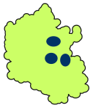
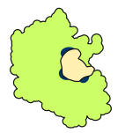

Anabolism
Substrate A
Substrate B
Enzyme
Anabolism is the build up or synthesis of complex molecules from simpler ones to make chemicals required by the cell.
This process requires energy.
Examples include:
  Protein synthesis: proteins are assembled from amino acids.
  Photosynthesis: glucose is made from water and carbon dioxide with the input of light energy.
Active sites
Substrate
molecules enter the enzyme’s active site(s).
Substrate subjected to stress which aids the formation of bonds.
Substrate molecules form a single product which is released
Product

Slide 24
Catabolism
Substrate
Catabolism is the break down of complex, high energy, molecules into simpler ones with lower energy.
This process releases energy, including heat to keep us warm.
Examples include:
  Digestion of food: carbohydrates, proteins, and fats are broken down into their constituent parts for absorption.
  Cellular respiration: glucose molecules are broken down to release energy (as ATP).
Enzyme
Substrate enters the active site(s).
Active sites
Substrate is subjected to stress facilitating the breaking of bonds.
Substrate is broken in two and the products are released.
Product A
Product B

Slide 25






Regulation of Metabolism
The overall activity of enzymes, and therefore metabolism, is controlled by a number of factors:
  The rate of enzyme production (by protein synthesis) and breakdown.
  The influence of cofactors and inhibitors
  Changes in the activity of the enzyme through its interaction with the substrate or the reaction products:
    Speed forward stimulation (interaction with substrate)
    Negative feedback (interaction with product)
Speed forward stimulation
Enzyme 1
Negative feedback
Enzyme 2
Substance A
Substance B
Substance C
Substrate
(starting chemical)
End product
(finishing chemical)

Slide 26
Regulation of Metabolism
Speed forward stimulation operates in cases where the substrate must be kept at a low concentration.
Negative feedback operates where high levels of the end product deactivates enzyme 1 at the beginning of the metabolic pathway
Enzyme 1
Enzyme 2
Substance A
Substance B
Substance C
Substrate
(starting chemical)
End product
(finishing chemical)

Slide 27
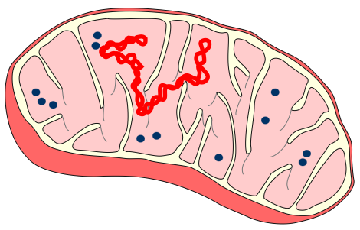
Location of Enzyme Activity
Enzymes are often located in specific regions of the cell, e.g. in mitochondria or chloroplasts.
This results in greater efficiency of function in the cell because the enzymes for a particular metabolic pathway (e.g. the respiratory chain enzymes in the mitochondria) can all be kept within a single type of organelle.
The rate of enzyme reaction in these cases is partly determined by the rate at which substrates can enter the organelle through the cell membrane.
Outer
membrane
Inner
membrane
Mitochondrial
DNA
Ribosome
Matrix
Cristae

Slide 28
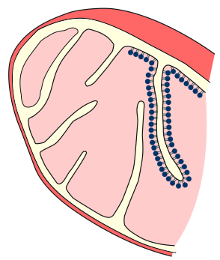
Enzymes within Cells
Enzymes do not always exist in isolation.
They are often grouped together and bound to the inner surface of membranes, e.g. in the mitochondria.
The enzymes are assembled together to catalyze several steps of a metabolic pathway.
The spatial arrangement of the enzymes orders the sequence of reactions, since the product of one reaction is the substrate for the next.
Amine oxidases and other enzymes on the outer membrane surface
Adenylate kinase and other phosphorylases between the membranes
Matrix
Respiratory assembly enzymes embedded in the membrane
Many soluble enzymes of the Krebs cycle, as well as enzymes for fatty acid degradation, floating in the matrix.
Cross-section through a mitochondrion

Slide 29




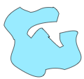
Metabolic Pathways
A metabolic pathway is a series of ‘steps’ from a starter molecule or precursor toward a final end product.
Each step is catalyzed by a different enzyme whose structure is encoded by a specific gene (or genes).
Gene A
Gene B
Protein synthesis produces enzyme A
Protein synthesis produces enzyme B
Enzyme A
Enzyme B
Enzyme A transforms the precursor chemical into the intermediate chemical by altering its chemical structure
Enzyme B transforms the intermediate chemical into the end product
Precursor chemical
Intermediate chemical
End product

Slide 30
Metabolism of Phenylalanine
Proteins are broken down to release free amino acids, one of which is phenylalanine
Protein
The essential amino acid phenylalanine is converted into many products via a series of enzyme controlled steps.
The metabolism of phenylalanine represents a metabolic pathway.
Failure of the enzymes controlling the metabolic pathway leads to a range of metabolic disorders.
Phenylalanine
essential amino acid
Thyroxine
Tyrosine
Melanin
Hydroxyphenylpyruvic
acid
Homogentisic
acid
Enzyme controlled steps
Maleylacetoacetic
acid
Carbon dioxide
and water

Slide 31
Errors in Metabolism 1
The faulty metabolism of phenylalanine is associated with various
disorders, depending on which step in the metabolic pathway is affected:
Protein
Mental retardation, 'mousy’ body odor, light skin color, eczema, excessive muscular tension and activity.
Phenylketonuria
Phenylalanine
essential amino acid
This in turn causes
Phenylalanine
hydroxylase
Faulty enzyme results in
buildup of
Phenylpyruvic
acid
a series of enzymes
Tyrosinase
Thyroxine
Tyrosine
Melanin
Faulty enzymes cause
Faulty enzyme causes
Dwarfism, mental retardation, low levels of thyroid hormones, retarded sexual development, yellow skin color.
Complete lack of the pigment melanin in body tissues, including the skin and hair
Cretinism
Trans-
aminase
Albinism
Hydroxyphenylpyruvic
acid

Slide 32
Errors in Metabolism 2
These metabolic disorders vary in degree of severity.
Hydroxyphenylpyruvic
acid
Hydroxyphenylpyruvic
acid oxidase
Death from liver failure or, if surviving, chronic liver and kidney disease.
Faulty enzyme causes
Tyrosinosis
Homogentisic acid
Dark urine, pigmentation of cartilage and other connective tissues, and, in later years, arthritis.
Homogentisic
acid oxidase
Faulty enzyme causes
Alkaptonuria
Maleylacetoacetic
acid
Carbon dioxide
and water

Slide 33
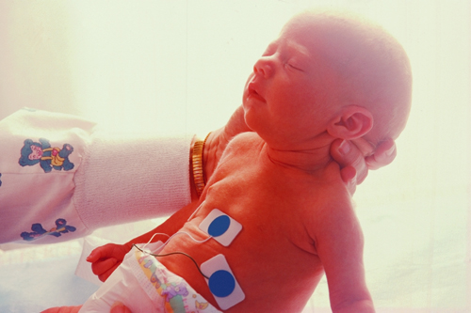
Inherited Metabolic Disorders
Phenylketonuria (PKU)
Caused by: | Faulty gene results in the absence of an enzyme in the liver, allowing phenylalanine to rise to harmful levels.
Leads to: | Brain damage.
Occurrence: | 1 in 19 400 newborn babies
Most inherited metabolic disorders are caused by faulty enzymes.
Some can be detected via a simple blood test in newborn babies (at 5 days).
Cystic Fibrosis
Caused by: | Abnormal control of secretions (body fluids).
Leads to: | Poor growth, chest infections, shortened life.
Occurrence: | 1 in 4100 newborn babies
Maple Syrup Urine Disease (MSUD)
Caused by: | Non-functional enzyme (3 amino acids involved).
Leads to: | Life-threatening complications.
Occurrence: | 1 in 166 500 newborn babies
Galactosemia
Caused by: | Enzyme defect prevents normal use of milk sugar.
Leads to: | Jaundice, cataracts, and severe illness.
Occurrence: | 1 in 67 600 newborn babies

Slide 34
Inherited Metabolic Disorders 2
Congenital Hypothyroidism
Caused by: | Not enough normal thyroid gland.
Leads to: | Slowed growth and mental development.
Occurrence: | 1 in 4900 newborn babies
Additional examples of inherited metabolic disorders caused by faulty enzymes:
Congenital Adrenal Hyperplasia
Caused by: | A deficiency in the hormones regulating salt balance and levels of testosterone (male sex hormone) in either sex.
Leads to: | Vomiting, dehydration and death within days. In girls: Genitalia appear masculine, despite female internal sex organs. In boys: Early development of secondary sex characteristics occurs.
Occurrence: | 1 in 22 900 newborn babies
Biotinidase Deficiency
Caused by: | A deficiency of three mitochondrial enzymes.
Leads to: | Neurological disorder and low pH of body fluids possibly leading to coma.
Occurrence: | 1 in 22 900 newborn babies

Slide 35
Regulating Enzyme Production
Cells need to control the rate and frequency of protein synthesis.
These controls often occur at transcription.
Sometimes genes are induced (and therefore transcribed) only when an enzyme product is required to catalyze reactions that may occur infrequently, e.g. use of a particular substrate that is not always available.
Other constituent genes are being transcribed all the time because their enzyme products are in constant demand, e.g. the genes coding for respiratory enzymes.
Transcription
Translation
Transcription stage may be switched ON or OFF
DNA
mRNA
Enzyme

Slide 36
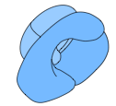




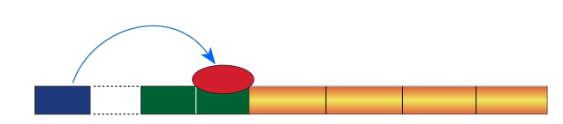
Regulating Enzyme Production
in Prokaryotes
In prokaryotes, operons control the rate of transcription.
An operon is a group of closely related genes that act together and code for the enzymes regulating a particular metabolic pathway.
A series of enzyme controlled reactions transforms the substrate into the end product. At each step, the chemical is altered slightly in its chemical makeup
Metabolic Pathway
Substrate
End product
Chemical 1
Chemical 2
Chemical 3
Chemical 4
Chemical 5
RNA polymerase
Enzyme A
Enzyme B
Enzyme C
Enzyme D
A repressor molecule may bind to the operator site
Functional enzymes
Progress may be blocked
Translation
Protein
synthesis
mRNA
Repressor
Transcription
Regulator
gene
Promoter
Operator
Structural gene A
Structural gene B
Structural gene C
Structural gene D
DNA
OPERON

Slide 37
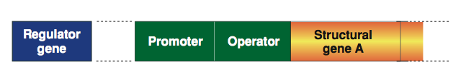
Structure of the Operon 1
The operon in prokaryotes comprises a number of different genes:
  Structural genes code for the production of the enzymes involved in a particular set of metabolic reactions.
  The promoter gene is the recognition site to which the RNA polymerase enzyme binds.
  The operator gene controls the production of mRNA.
  A regulator gene, outside the operon, can produce a repressor molecule which can block the operator gene.
Located outside the operon
DNA strand
OPERON
The operon consists of the structural genes and the promoter and operator sites

Slide 38
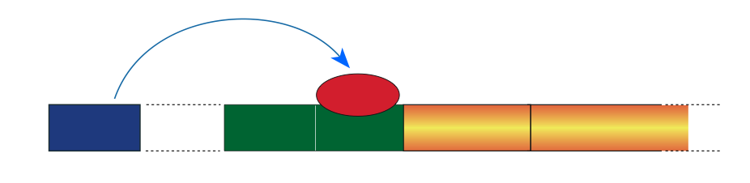
Structure of the Operon 2
RNA polymerase
The RNA polymerase enzyme creates a mRNA copy of the structural genes to initiate protein synthesis
An active repressor molecule will bind to the operator site
At least one structural gene is present. Structural genes code for the creation of an enzyme in a metabolic pathway.
Protein
synthesis
Progress may be blocked
Repressor
Regulator
gene
Promoter
Operator
Structural gene A
DNA
The regulator gene, away from the operon, produces the repressor molecule by protein synthesis
The promoter site is where the RNA polymerase enzyme first attaches itself to the DNA to begin synthesis of the mRNA
The operator is the potential blocking site. It is here that an active repressor molecule will bind, stopping mRNA synthesis from proceeding.
OPERON
The operon consists of the structural genes and the promoter and operator sites

Slide 39
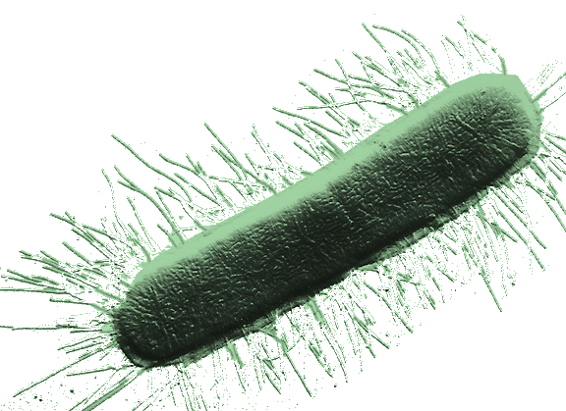

Operon Function in Prokayotes
Two alternative processes can operate to control operon activity:
    Induction: In which gene transcription is switched ON
      Gene is normally switched off
      A substrate, e.g. lactose, acts as an inducer so that genes are transcribed
    Repression: In which gene transcription is switched OFF
      Gene is normally switched on.
      An end-product, e.g. tryptophan, acts as an effector to activate a repressor molecule and switch transcription off.
Both gene induction and repression have been well studied in E. coli. This organism will switch on and off enzyme systems as required.

Slide 40
Gene Induction 1
In gene induction, the genes are normally switched off, but are switched on when they are required. Example: the lac operon in E. coli .
The prefix lac refers to the substrate involved, which is lactose.
Step 1: Production of the repressor protein
    The regulator gene produces a protein, called a repressor.
    With no lactose, the repressor blocks the binding site of RNA polymerase.
    Genes coding for the enzymes for lactose metabolism are not transcribed.
The repressor blocks the operator site. The RNA polymerase bind cannot transcribe the structural genes.
RNA polymerase synthesizes mRNA
The regulator gene on another part of the chromosome produces a protein called a repressor.
Repressor
DNA strand

Slide 41
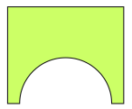
Gene Induction 2
When lactose is present, it may act as an inducer molecule.
Step 2: The inducer binds to the repressor protein
  This is a reversible reaction that happens only if the inducer (in this case the substrate lactose), is in high concentration.
  The inducer binds to the repressor, preventing it from binding to the operator.
  RNA polymerase can then bind and the structural genes can be transcribed.
Inducer binds to the repressor, altering its shape so it is no longer able to bind to the DNA
The inducer may be the substrate for the beginning of the metabolic pathway.
Inducer
Repressor
Repressor

Slide 42
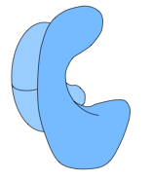
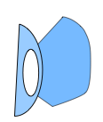


Gene Induction 3
Step 3: Gene transcription and enzyme synthesis
  Once the repressor is deactivated, RNA polymerase can bind to the operator gene.
  mRNA is transcribed in a continuous piece, coding for all of the structural genes in the operon.
  The enzymes are produced in a sequence that reflects the stages in the metabolic pathway that they code for.
  Gene induction enables the production of specific enzymes only when there is a need (i.e. enzyme production is induced by the presence of the substrate).
RNA polymerase produces one continuous piece of mRNA for all the structural genes in the operon
mRNA
With the repressor removed, RNA polymerase can get access to the operator gene and begin transcribing the structural genes.
RNA polymerase

Slide 43
Gene Induction
RNA polymerase synthesizes mRNA
Inducer binds to the repressor, altering its shape so it is no longer able to bind to the DNA
The inducer may be the substrate for the beginning of the metabolic pathway.
Inducer
The repressor blocks the operator site. The RNA polymerase bind cannot transcribe the structural genes.
RNA polymerase produces one continuous piece of mRNA for all the structural genes in the operon
Repressor
Repressor
Repressor
DNA strand
The regulator gene on another part of the chromosome produces a protein called a repressor.
With the repressor removed, RNA polymerase can get access to the operator gene and begin transcribing the structural genes.
1
2
3

Slide 44

Gene Repression 1
In gene repression systems, the operon is normally switched ON. The genes are turned off when the end product is present in large quantities.
  An effector molecule is required to activate the repressor.
  The effector molecule is usually the end product of a metabolic pathway.
Step 1: The repressor is at first inactive
When the effector (the end product) is in low concentration, the repressor molecule is the wrong shape to bind to the operator site.
The regulator gene on another part of the chromosome produces a protein called a repressor.
Transcription proceeds uninterrupted
Repressor
Example: tryptophan synthesis in E.coli.
RNA polymerase

Slide 45
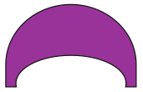
Gene Repression 2
Step 2: The repressor is activated
  When the effector (end product) is in high concentration it binds to the repressor and changes its shape.
Effector
Effector in high concentration
The repressor molecule has its shape changed as the effector molecule binds to it. This only occurs when the effector is in high concentration
Repressor
Repressor

Slide 46
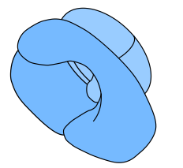

Gene Repression 3
Step 3: The repressor binds to the operator
  The shape change of the repressor molecule enables it to bind to the operator.
  As a result, transcription is switched off. The structural genes cannot be transcribed because the RNA polymerase cannot bind to the promoter site.
RNA polymerase is prevented from binding to the promoter site to begin transcription
Effector
The now active repressor molecule is able to bind to the operator site and prevent transcription
Repressor

Slide 47
Gene Repression
Effector
When the effector (the end product) is in low concentration, the repressor molecule is the wrong shape to bind to the operator site.
The repressor molecule has its shape changed as the effector molecule binds to it. This only occurs when the effector is in high concentration
Repressor
The regulator gene on another part of the chromosome produces a protein called a repressor.
RNA polymerase is prevented from binding to the promoter site to begin transcription
The now active repressor molecule is able to bind to the operator site and prevent transcription
Transcription proceeds uninterrupted
Repressor
1
2
3

Slide 48
Summary of Gene
Regulation in Prokaryotes
In prokaryotes, genes can occur as operons which can be switched on or off by regulating genes.
In gene induction:
  Genes that are induced are normally switched off.
  The inducer is the substrate that becomes available, e.g. lactose.
  The presence of the substrate deactivates the repressor allowing transcription of structural genes to proceed.
In gene repression
  Genes that are repressible are normally switched on.
  The presence of high levels of the end product of a metabolic process (e.g. tryptophan) activates the repressor molecule.
  The active repressor prevents further transcription of the structural genes.

Slide 49
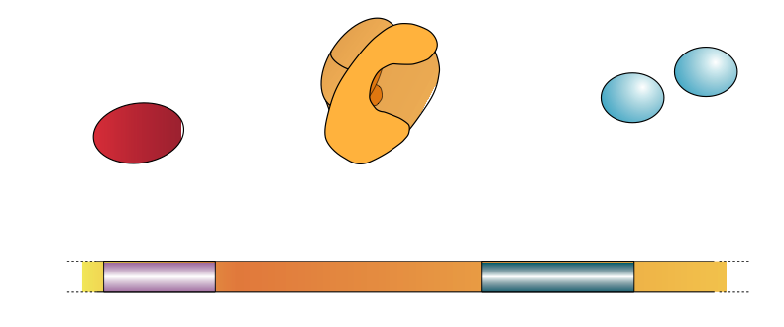
Eukaryotic Gene Control
The control of gene expression in eukaryotes is similar in nature,
but more complex than that in prokaryotes.
Eukaryotic genes have a relatively large number of control elements.
  Control elements, such as the enhancer sequence, are non-protein-coding sections of DNA that help regulate transcription by binding proteins called transcription factors.
RNA polymerase
Transcription factors that bind to RNA polymerase
Transcription factors (activators) that bind to the enhancer sequence
Promoter region of DNA
Enhancer sequence of DNA
Coding region of gene

Slide 50
Role of Transcription Factors
Each functional eukaryotic gene has a promoter region where the RNA polymerase binds and begins transcription.
Eukaryotic RNA polymerase cannot, on its own, initiate transcription.
  It depends on transcription factors to recognize and bind to the promoter.
  Transcription factors also bind to the enhancer sequence of DNA
RNA polymerase
Transcription factors that bind to RNA polymerase
Transcription factors (activators) that bind to the enhancer
Promoter region of DNA
Enhancer sequence of DNA
Coding region of gene

Slide 51
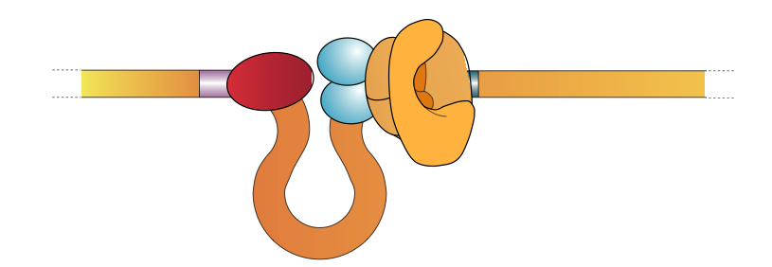
Activating Transcription
Transcription is activated when a hairpin loop in the DNA brings the transcription factors on the enhancer sequence (activators) in contact with the transcription factors bound to the RNA polymerase at the promoter.
  Protein-protein interactions are crucial to eukaryotic tanscription.
  The RNA polymerase can only produce a mRNA molecule once the complete initiation complex is assembled.
Transcription factors bound to RNA polymerase
Activators
Enhancer
Promoter
Transcription proceeds until a terminator sequence is encountered. Then transcription stops.
RNA polymerase
Initiation complex

Slide 52

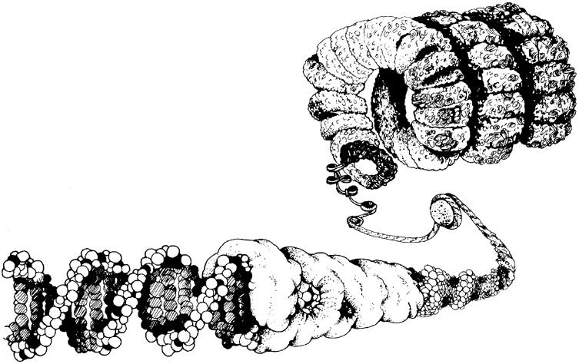
Control of Metabolism
Control of metabolism can occur at many levels: at the level of DNA, at the transcriptional level, when mRNA is being translated, or after the protein is made.
Control at the DNA level
  Gene deactivation: In eukaryotes
  chromatin sometimes remains ‘packed up’
  and is not transcribed e.g. Barr bodies.
  There may be multiple copies of
  genes coding for products required
  in high levels.
Chromatin:
A complex of DNA and protein
Histone protein
DNA molecule
(double helix comprising genes)

Slide 53


Control of Metabolism
Transcriptional control:
  The primary RNA transcript can be modified by the removal of intronic RNA (non-protein-coding sequences).
  Genes can be switched on or off with repressors.
Double stranded DNA
Exon
Intron
Both exons and introns are transcribed
Primary RNA transcript
The primary RNA transcript is edited
Introns are removed and exons are spliced together
The repressor blocks the binding site for transcription of structural genes
Repressor
The regulator gene produces a protein called a repressor
DNA strand

Slide 54



Control of Metabolism
Post-transcriptional control:
  The rate of ribosome attachment and detachment controls speed of translation.
  The rate of translation can be controlled by the length of life of the mRNA.
Incoming ribosomal subunits
Completed polypeptide
Growing polypeptide
Ribosomes subunits detach
Typically, a number of ribosomes work on translating the mRNA at the same time.These polyribosomes are found in both prokaryotic and eukaryotic cells.
Start of mRNA
(5’ end)
End of mRNA
(3’ end)

Slide 55

Control of Metabolism
Post-translational control:
  The rate of enzyme degradation controls the amount of an end product.
  Feedback inhibition can prevent the functioning of enzymes in the initial steps of a metabolic pathway.
  Enzymes may be synthesized in an inactive form e.g. protein digesting enzymes that would be dangerous if stored in the active form.
  Proteins can be modified by the addition of other molecules, e.g. carbohydrates, which alter the function of the protein.
Enzyme
Substance A
Substance B
Substrate
End product
Feedback inhibition
44-amino acid segment (red) is cleaved at ph<5.0
Pesinogen; precursor to pepsin

Slide 56

Control of Metabolism
Compartmentation:
  Enzymes can be restricted within cells to different organelles, e.g. respiratory enzymes in mitochondria.
  The reaction rate will be limited partly by the speed at which substrates enter the organelle.
  Specific types of enzymes are often found in certain organs e.g. enzymes catalyzing the reactions of the urea cycle are found mainly in the liver.
Amine oxidases on the outer membrane surface
Adenylate kinase between membranes
Matrix
Respiratory assembly enzymes embedded in the membrane
Many soluble enzymes of the Krebs cycle floating in the matrix
Cross-section through a mitochondrion: diagram (above) and TEM (left)

Slide 57


Slide 58
Terms of Use
Biozone International retains copyright to the intellectual property included in this presentation file, with acknowledgement that certain photos are used under license and are credited appropriately on the next screen.
You MAY:
  Use these slides for presentations in your classrooms using a data projector, interactive whiteboard, and overhead projector.
  Place these files on the school’s intranet (school computer network), but not in contradiction of clause 3 (a) below.
  Edit and customize this file by adding, deleting, and modifying information to better suit your needs.
  Place these presentation files on any computer within the school, including staff laptops.
  Print out this file in PowerPoint “Handouts” format as per the print dialogue box, for the express purpose of allowing students to make their own notes about the presentation.
You MAY NOT:
  Put these presentation files onto the internet or on a service that may be accessed offsite from the campus, unless access to the service is protected by a user login and password protocol.
  Print these files onto paper to make your own worksheets for distribution to students.
  Create a NEW document using any of the graphics/images in this presentation file.
  Incorporate any part of this presentation file for the production of another commercial product.
  REMOVE any of the references to Biozone, the copyright notices, photo credits, or terms of use from this file.

Slide 59
Photo Credits
Photographic images are used under licence from the following photo libraries:
  Corel Corporation Professional Photos
  (various titles, including: Science & Medicine, Agriculture).
  ArtToday.com
  Clipart.com
  PhotoDisc Inc.
  Hemera Technologies Inc.
  PhotoObjects.com
  CDC Public Health Image Library (PHIL)
Additional artwork and photographs are the property of Biozone International Ltd.
BIOZONE International Ltd | P.O. Box 13-034, 109 Cambridge Road, Hamilton, NEW ZEALAND
Phone: + 64 7 856-8104 | Fax: + 64 7 856-9243 | E-mail: sales@biozone.co.nz | Internet: www.biozone.co.nz
Copyright © 2005 Biozone International Ltd
All rights reserved

Slide 60







Presentation MEDIA
See our other titles:
See full details on our web site:
www.thebiozone.com/media.html

